Slide 1
VAMC Pittsburgh Modernization User Research
Prepared by the Digital Service at Veterans Affairs (DSVA)
March 2019

Slide 2
Outline
We gathered feedback from hundreds of Veterans about our plans for a new experience on VAMC Pittsburgh.
Study 1 – Navigation Tree Test
Study 2 – Services Listing Card Sort

Slide 3
Study 1 – Navigation Tree Test

Slide 4
Our goal was to assess whether our planned left navigation allowed Veterans clear access paths.
Study objectives
How many first clicks go to the primary “Locations and Services” section.
Are any of the labels distractors?
Are the labels “Our Locations”, “Health Services”, and “Patient and Family Services” working as we intended them to?

Slide 5
We asked Veterans where they would go to accomplish top VAMC website tasks
Research Method
Created an tree test in Optimal Workshop
13 top tasks, each participant saw 10
Distributed to 5k Veterans via MyHealtheVet mailing list
Received 211 responses (Feb 8 - 11)
98% Veterans, a few spouses and caregivers

Slide 6
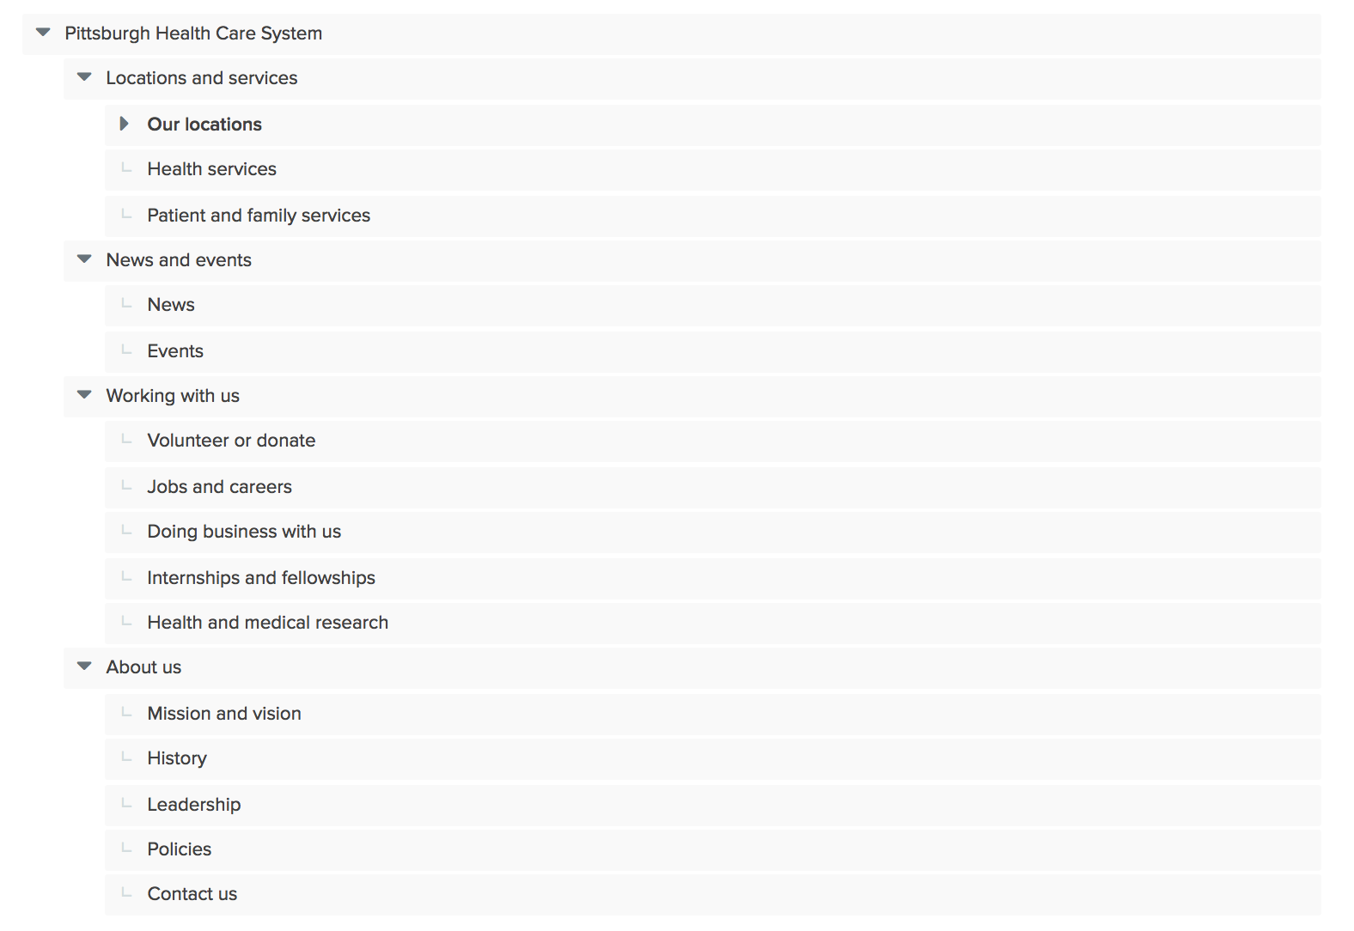

Slide 7
Overall, the navigation needs a little work
Findings
Average task success was 45% across the 13 tasks (target is 60% or higher)
Veterans looked for almost everything under “Health Services”
Examples: Patient Advocate, Enroll in HC, Billing, Women Veteran Care
There was significant confusion between “Health Services” and “Patient and Family Services”
Veterans went to “Locations and Services” first 70% of the time (correctly)
The “Working with Us” label was a big distractor for the about-type tasks.
Billing (4), Patient Advocate (4)
”About Us” was a distractor for a few tasks averaging 10% first click.
Tasks that were clearly health-related or non-health tested well
Examples: Hearing Care (7), Primary Care (6), Volunteer (7)

Slide 8
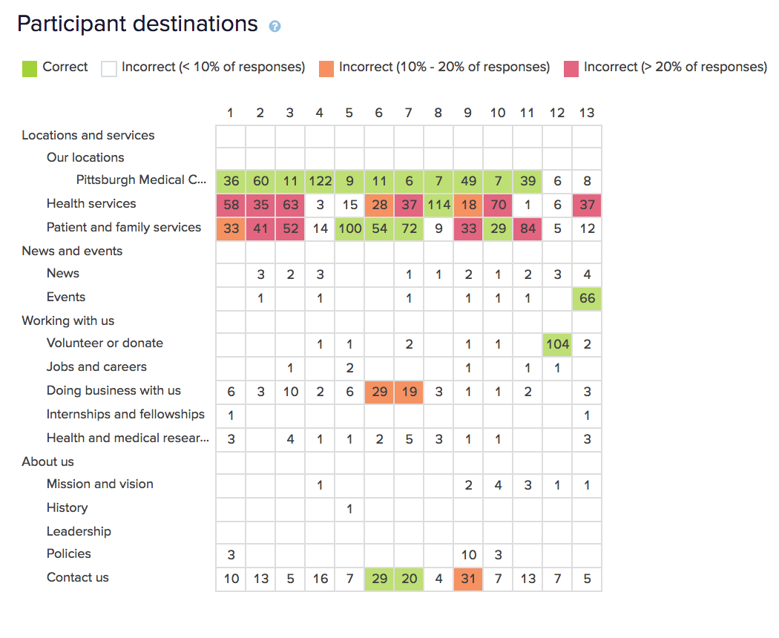

Slide 9
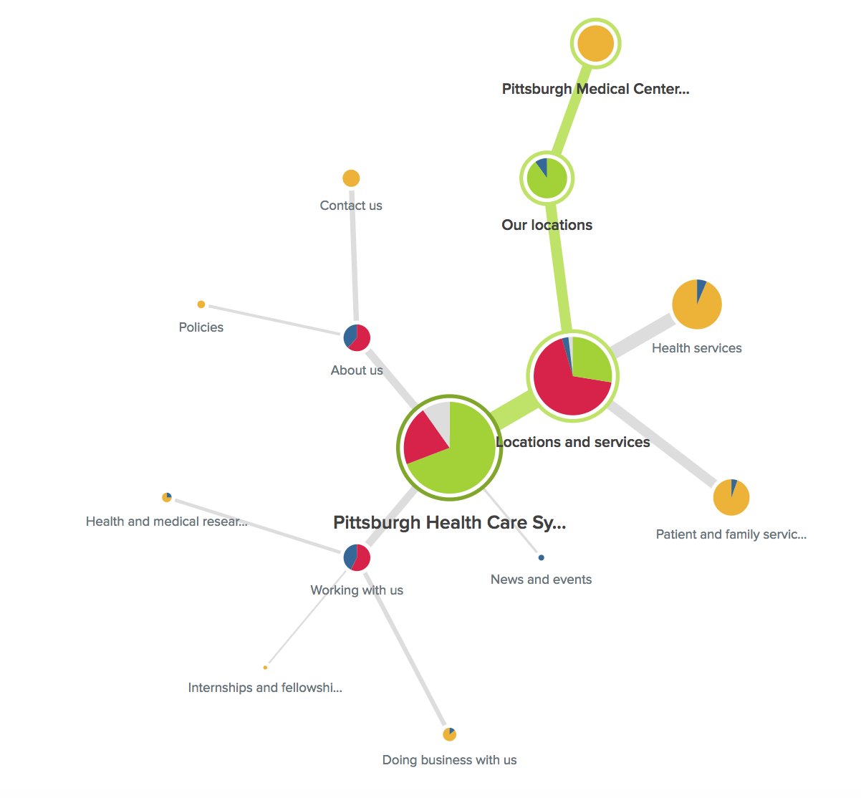
“You recently separated from service and are ready to enroll in VA health care. Where would you go to do that?”
Overall Score - 3

Slide 10
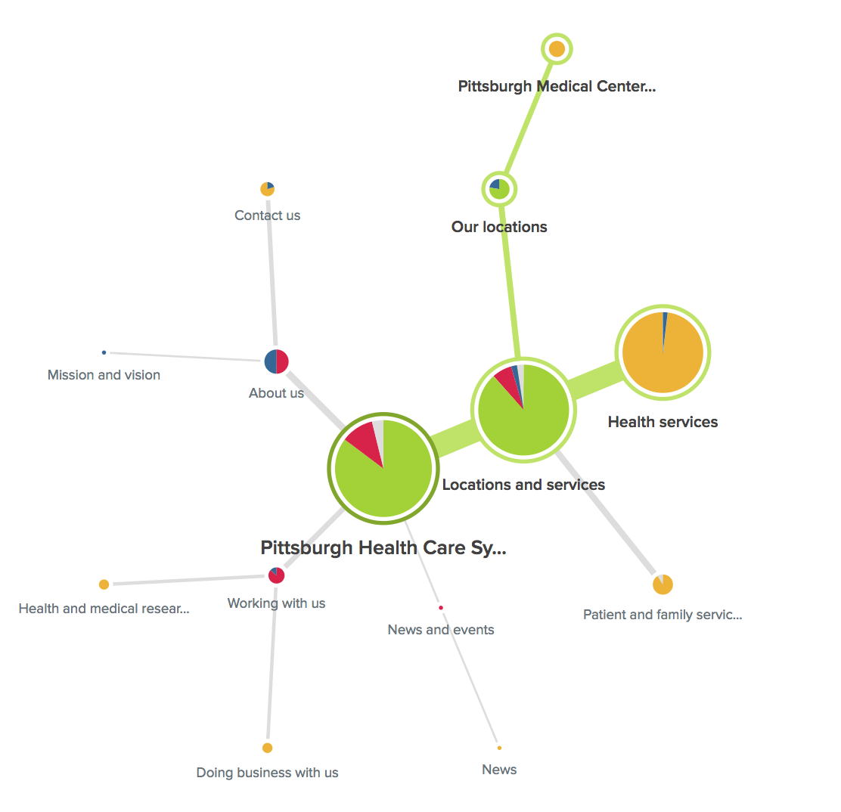
“You are having some issues with your hearing and want to know if your clinic has specialists that provide care for hearing issues.”
Overall Score - 7

Slide 11
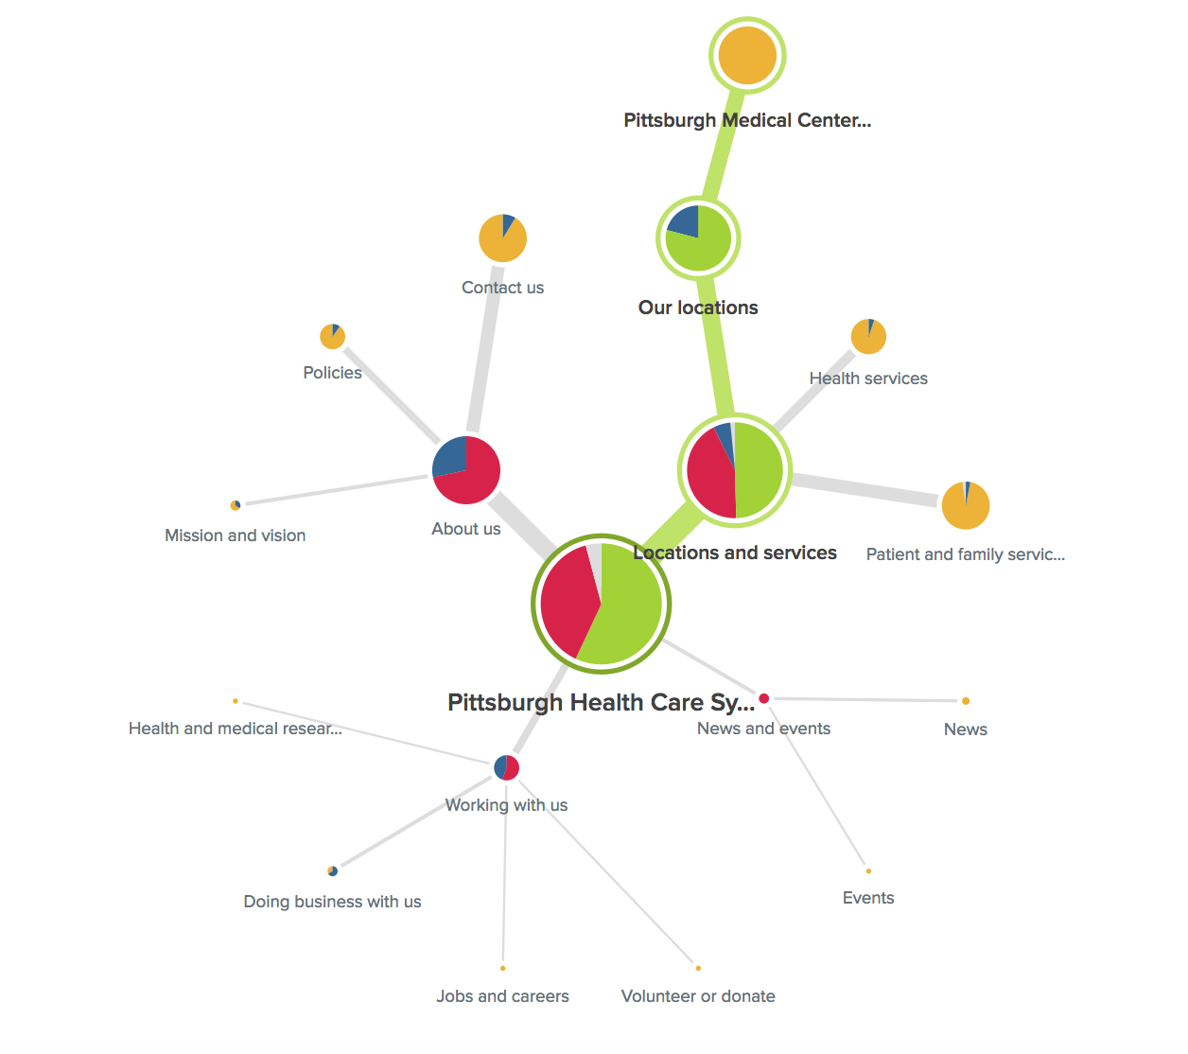
“Where would you look to find the visiting hours for your VA clinic?”
Overall Score - 3

Slide 12
We confirmed that some things are working well
findings
Most Veterans correctly used the “Locations and Services” label
The Facility page was found consistently and was not a distractor
”News and Events” was not a distractor for top tasks

Slide 13
We have a few clear things to work on
recommendations
Crosslink the Health Services and Patient and Family Services Pages
Provide access to appointment scheduling and enrollment in the “About Us” section
Change the label for either “About Us” or ”Working with Us” to reduce confusion
The events list needs to linked on the local facility pages
Link to visiting hours on the ”Contact Us” page

Slide 14
Did we reach our goals for this study?
Outcomes
How many first clicks go to the primary “Locations and Services” section.
70% Average, working well
Are any of the labels distractors?
Yes, particularly Health Services and Patient and Family Services
Are the labels “Our Locations”, “Health Services”, and “Patient and Family Services” working as we intended them to?
Our Locations – Yes
Health Services - No
Patient and Family Services - No

Slide 15
What Now?
Recommendations
We need to make updates to our left navigation and implement crosslinking. Additional tree testing and usability sessions are needed to verify the new IA works for Veterans.

Slide 16
Study 2 – Services Listing Card Sort

Slide 17
Our goal was understand if our Service buckets make sense to users
Study objectives
Are services consistently sorted into the three buckets?
Health services
Patient and family services
Locations and services (aka Facility Services)
Which services are most difficult to sort?
Do we need to make any updates to the buckets or service labels?

Slide 18
Veterans showed us which of the buckets they expected to find the Service in
Research Method
Created a closed card sort in Optimal Workshop
44 cards, each participant sorted 15
3 categories
Distributed to 5k Veterans via MyHealtheVet mailing list
Received 348 responses (Feb 26 – Mar 1)
98% Veterans, several spouses

Slide 19
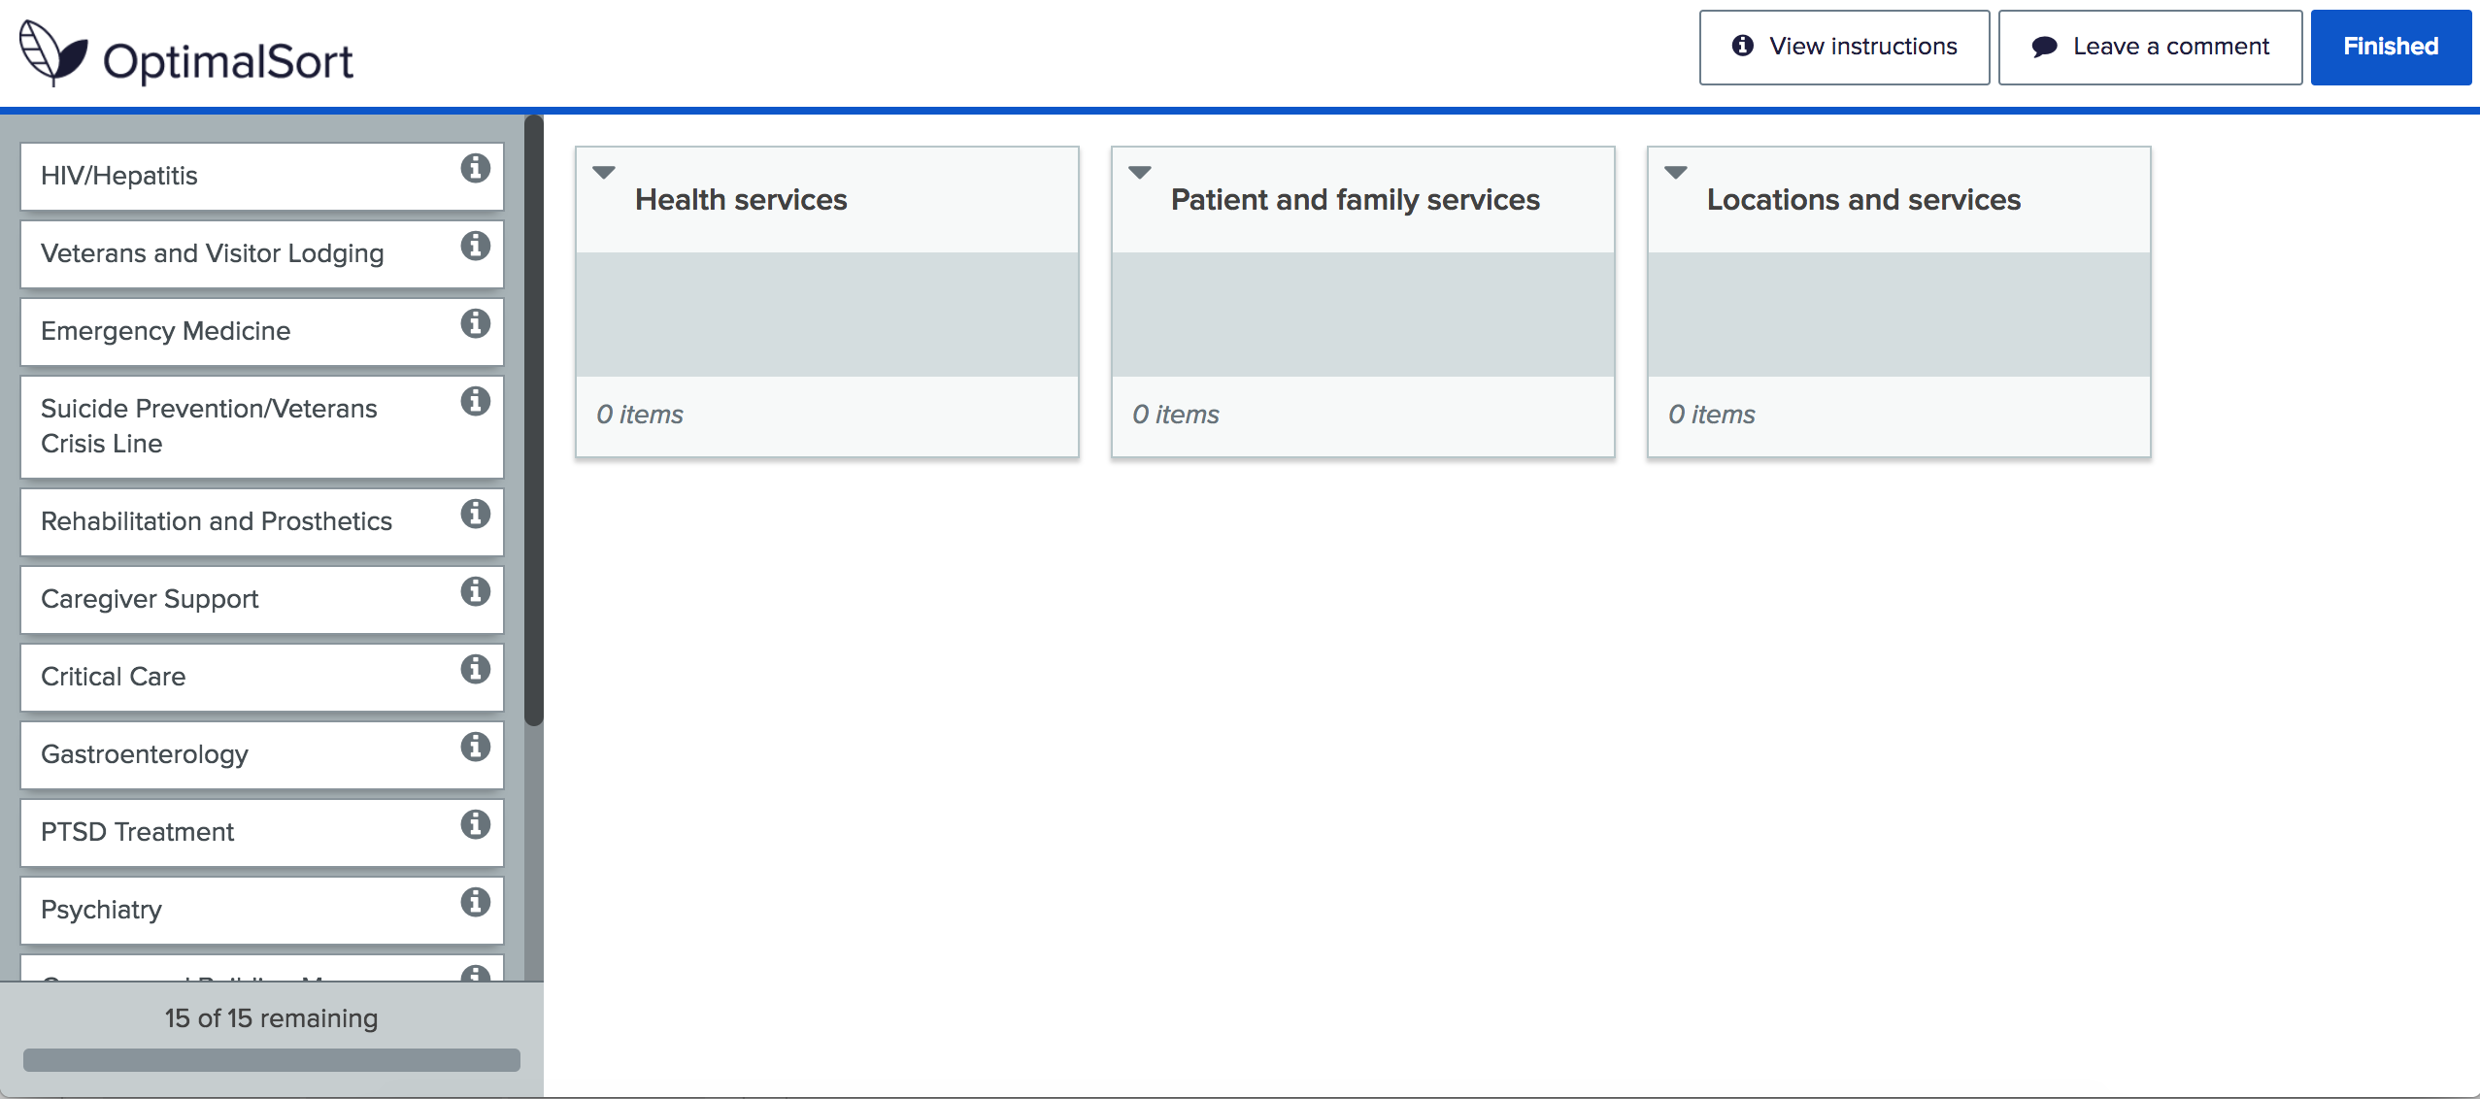

Slide 20
Breakdown of how frequently Veterans sorted the services into our planned categories
Findings
Health services (21 cards) – averaged 78%
Patient and family services (15 cards) – averaged 50%
Locations and services (8 cards) – averaged 63%

Slide 24
Services that did not fit neatly
findings
Health and Patient/Family
Addiction and Substance Abuse
Suicide Prevention/VCL
Registry Exams
Nutrition, Food, Dietary
MOVE! Weight Management
Women’s Health
Low Vision and Blind Rehab
Patient/Family and Location
Compensated Work Therapy/VR&E
MHV Coordinator
Veterans Visitor Lodging
Wheelchair Mobility
Lodging for Patients and Families
Visitor Hours and Info

Slide 25
We learned that the health services and locations categories work but patient and family does not
Findings
Health services were consistently sorted accurately
Patient and family services were all over the place
Locations and services were generally good, although there was overlap with Patient and family
Rehabilitation-type services (blind rehab, wheelchair mobility, etc.) are particularly difficult to place
Pharmacy belongs everywhere

Slide 26
Did we reach our goals for this study?
Outcomes
Are services consistently sorted into the three buckets?
Health services - Yes
Patient and family services - No
Locations and services (aka Facility Services) - No
Which services are most difficult to sort?
Patient and family services, Pharmacy
Do we need to make any updates to the buckets or service labels?
Yes, we need to address the major miscategorized services

Slide 27
What Now?
Recommendations
We learned a lot about how Veterans view these services. We need to move services to their most commonly placed location and find ways to crosslink for the most difficult services to sort.

Slide 28
Thank you!
Contact Jeff Barnes with questions:
jeffrey.barnes4@va.gov

